Slide 1



SoI Architecture Group
03 Aug 2017

Slide 2
Agenda
Group Description
Group Objectives
Group Accomplishments
Lessons Learned
Recommended Future Directions

Slide 3









Group Description
Primary goal: Develop a formal architecture for UxAS in an assume/guarantee framework
Team Members
Sean Regisford – AFRL
Aaron Fifarek – LinQuest (LQ)/AFRL
Brian Hulbert – LinQuest (LQ)/AFRL
Jen Davis – Rockwell Collins (RC)
Chris Elliott – Lockheed Martin (LM)
Ratnesh Kumar – Iowa State University (ISU)
Cat McGhan – University of Cincinnati (UC)
Paul Meng – GE
Hao Ren – Honeywell (H)
Ben Rodes – Dependable Computing (DC)
Han Yu – GE
Do we want the Air Force emblem here too?

Slide 4
Storyline (to be deleted and spoken instead)
Wanted to formalize UxAS to enable analysis
Found issues along the way. Fixed some.
Gave us insights.
To do this, we needed to capture contracts for the components in a formal language.

Slide 5
Group Objectives
Develop a formal architecture for the current state of UxAS in an assume/guarantee framework
Identify strengths, weaknesses, and problems for the current architecture
Document decisions made along the way with supporting rationale
Make / begin to implement a revised formal architecture to mitigate challenges
(Non-objective) We did NOT attempt to prove that the component contracts are true for the existing C++ code for UxAS.

Slide 6
Group Accomplishments
REMOVE (If keeping next slide)
Extracted data types, input and output ports, and connections from code into both AADL/AGREE and ASSERT (LQ/AFRL, GE, RC)
Created formal contracts for eight services and tasks based on the OpenUxAS Wiki and conversations with the developer (DC, RC)
Stated and analyzed properties of these component-level contracts (DC, RC)
Idioms and lemmas developed and documented for effective use of AGREE (DC, RC)
Developed tool to compose component contracts into a system contract (H, ISU)
Added support for timing with finite history (i.e., “previous”)
Created an assurance argument for state machine correctness (DC)
Abstraction of task service finite state machine for simulation and formal analysis (LM)
Connected UxAS to the Robot Operating System (ROS) (UC)
All related?
How important do we want this to be
How important do we want this to be

Slide 7
Group Accomplishments
Extracted data types, input and output ports, and connections from code into both AADL/AGREE and ASSERT (LQ/AFRL, GE, RC)
Formalization in AADL/AGREE:
Created formal contracts for eight services and tasks based on the OpenUxAS Wiki and conversations with the developer (DC, RC)
Stated and analyzed properties of these component-level contracts including timing aspects (DC, RC, LQ)
Idioms and lemmas developed and documented for effective use of AGREE (DC, RC)
Formalization in ASSERT:
Created an ontology of the system (GE)
Examined contractual obligations of a representative component (GE)
Developed tool to compose component contracts into a system contract (H, ISU)
Added support for timing with finite history (i.e., “previous”)
Created an assurance argument for state machine correctness (DC)
Abstracted a task service finite state machine in Stateflow for simulation and formal analysis (LM)
Connected UxAS to the Robot Operating System (ROS) (UC)

Slide 8
Developing the UxAS Formal Representation

Slide 9
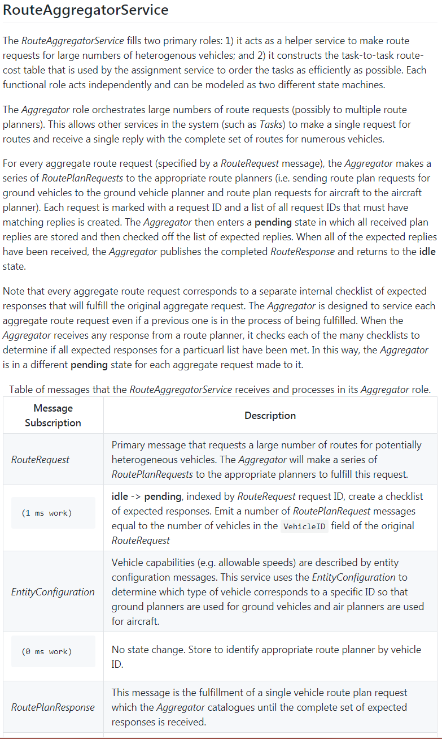
Producing the Formal Architecture
These are bullets to be revised and graphics to be generated.
The formal architecture relied on the documentation that was found on the UxAS Wiki page.
Direct code decomposition was going to be too intensive to meet objectives efficiently.
Through formalization, gaps were identified.
Team members and SMEs exposed:
Behavior that was not desired
Design decisions that gave components similar but different roles
Clarification on how components were envisioned to work but currently do not
Just the effort to formalize components proved extremely valuable to the SMEs, even before the analysis.

Slide 10
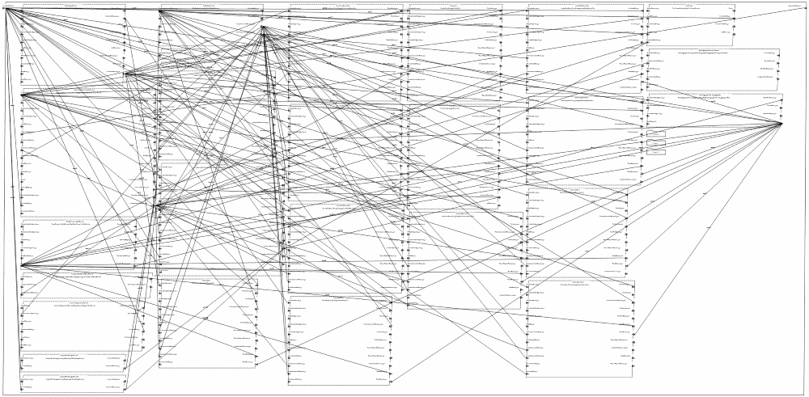
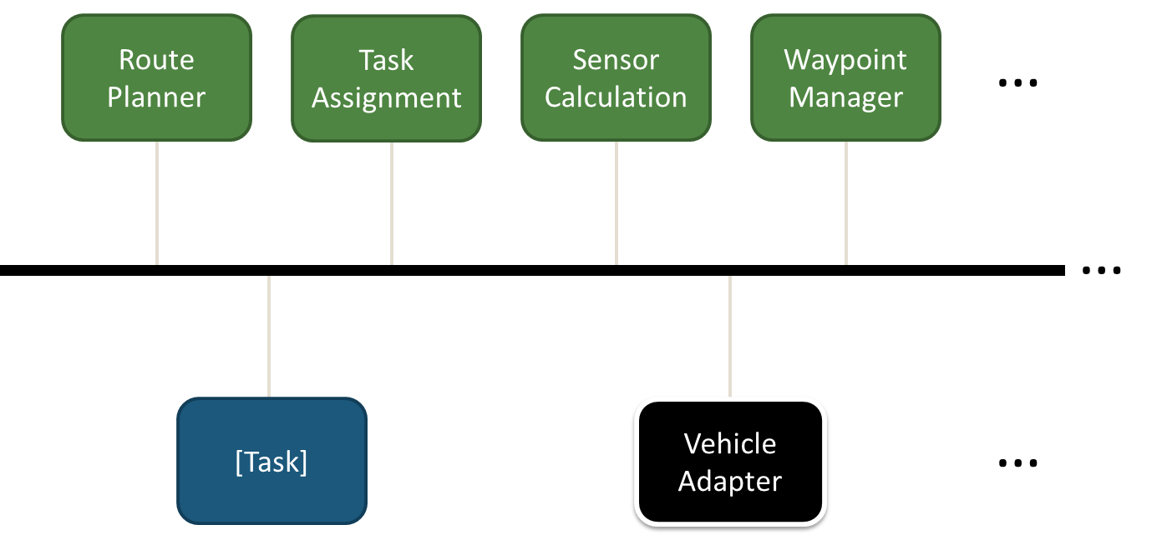
Formalization in AADL/AGREE Formalize Services
These are bullets to be revised and graphics to be generated.
Animate in the AADL connections diagram
Authored a script to extract data types, input/output ports, and connections from code
Abstracted the common message bus by direct port connections
The “structure” of the Waterways mission instantiation of UxAS is nearly complete
Created formal contracts (capturing behaviors) for eight services and tasks based on the OpenUxAS Wiki and conversations with the developer
Waterways system level AADL connections diagram
Make/pull a AADL connection image here showing interaction of a few components

Slide 11
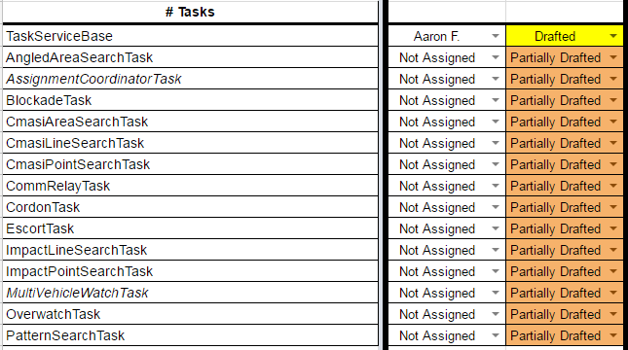
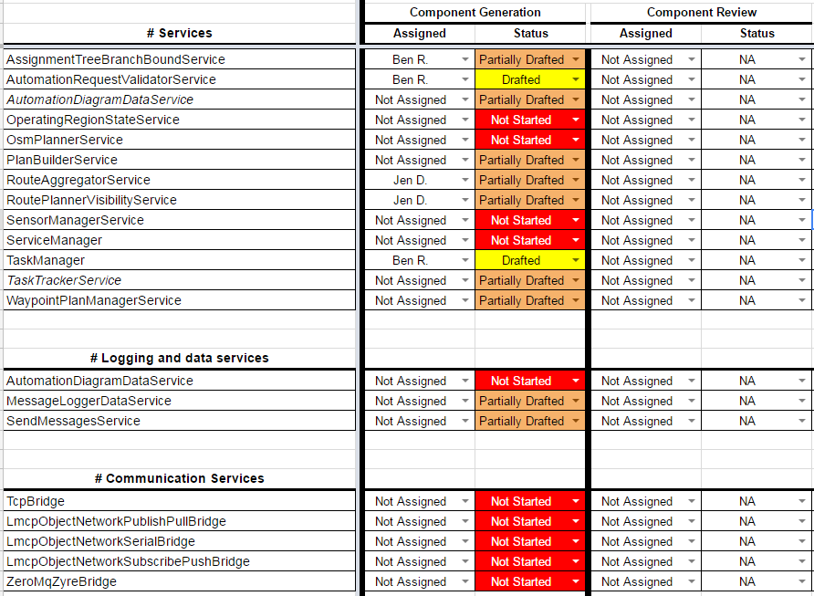
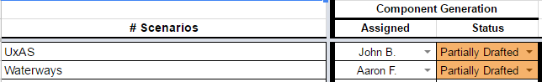
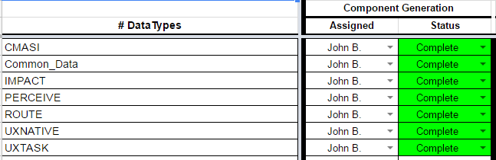
Formalization in AADL/AGREE UxAS Formal Model Status
Add legible headers for all sections
UPDATE

Slide 12

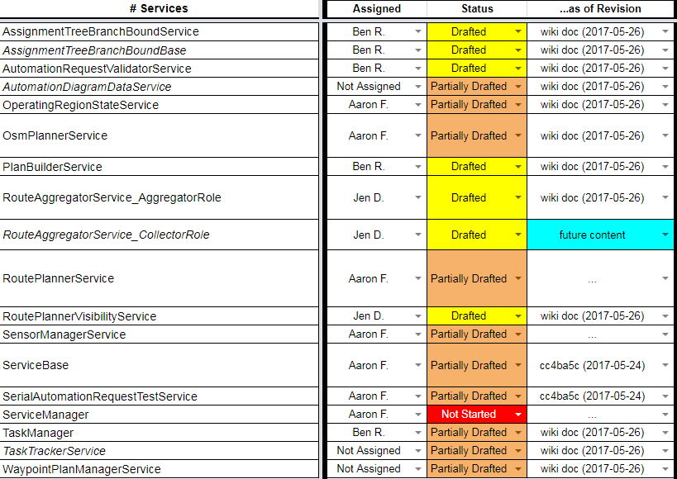
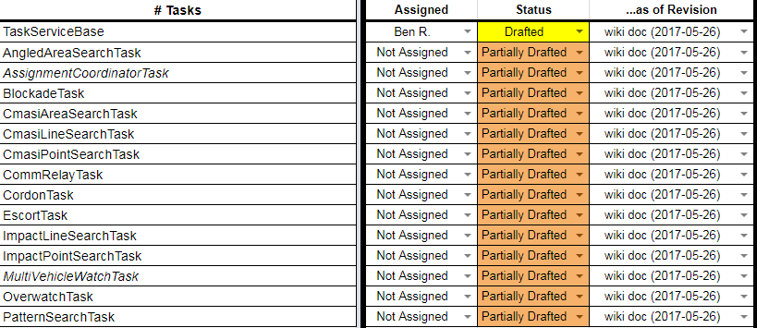
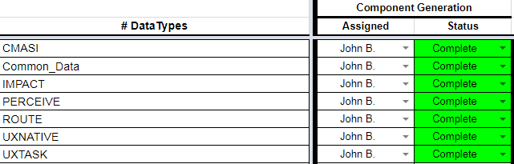
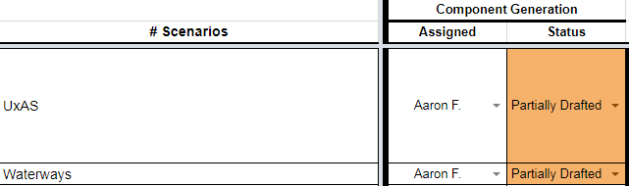
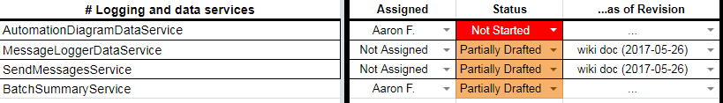
Formalization in AADL/AGREE UxAS Formal Model Status
Add legible headers for all sections

Slide 13

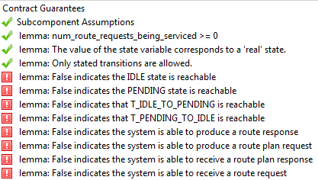
Formalization in AADL/AGREE What Did We Prove?
These are bullets to be revised and graphics to be generated.
Aaron: We didn’t prove much that didn’t involve state machines. The only other lemmas I see are that the number of messages being processed is nonnegative and that the size of a queue is nonnegative and at least sometimes positive. These are kind of odd things to show in a presentation I think.
Realizability—check that a component implementation is possible and that there are no conflicts amongst the guarantees in the component’s contract
Assume/guarantee reasoning—check higher-level guarantees and lemmas using the guarantees of the subcomponents, and check that the assumptions of the subcomponents hold
Can check that all input/output events are possible
Timing
Some analysis results for the RouteAggregatorService
(AggregatorRole):
Show some images of the analysis “green checks”
Show some components that the contracts resolve
State what realizability and entailment shows here
Talk about the timing properties capability

Slide 14
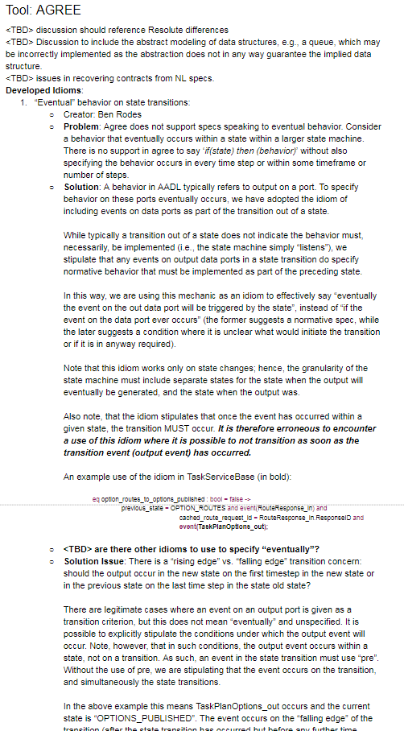
Formalization in AADL/AGREE What Did We Learn?
These are bullets to be revised and graphics to be generated.
Idioms and lemmas developed and documented for effective use of AGREE
Aaron: Almost all the idioms and lemmas are only applicable to state machines as I recall.
Insert a image of some of the idiom document
Pull some points from the document such as multiple

Slide 16

Formalization in ASSERT Proposed Approach
Extract architecture information through reverse engineering.
Transform extracted architecture information into SADL ontology.
Import SADL ontology into ASSERT™ to enable requirement capture, analysis, and test generation in ASSERT™
Software Codebase
(C, C++, Java, C#, Python, Ada, …)
Reverse Engineering
Software Design Information
Architecture Information Extraction
Architecture & Ontology Mapping Template
Automated Ontology Generation
Ontology Model
ASSERT™ SADL Ontology files
(.sadl files)
*SADL: Semantic Application Design Language

Slide 17
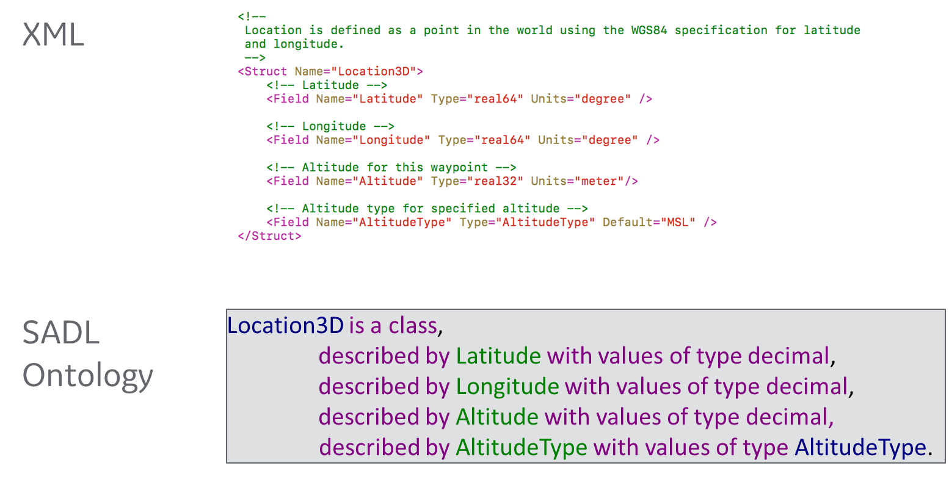
Formalization in ASSERT Modeling Message Type Definition in SADL Ontology

Slide 18
Formalization in ASSERT Modeling Dataflow in SADL Ontology
Illustrative Example in SADL Ontology
Context:
TaskAssignmentSummary__Subscription of PlanBuilderService is TaskAssignmentSummary_out of AssignmentTreeBranchBoundBase
and
TaskImplementationRequest__Subscription of TaskServiceBase is TaskImplementationRequest_out of PlanBuilderService
and
…
AssignmentTreeBranchBoundBase
TaskAssignmentSummary_out
PlanBuilderService
TaskImplementationRequest_out
TaskAssignmentSummary_Subscription
TaskServiceBase
TaskImplementationRequest_Subscription

Slide 19
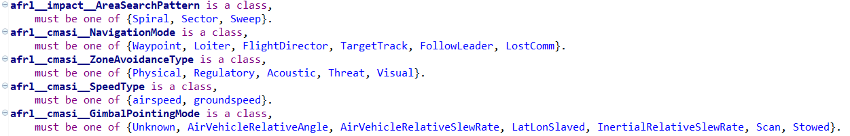
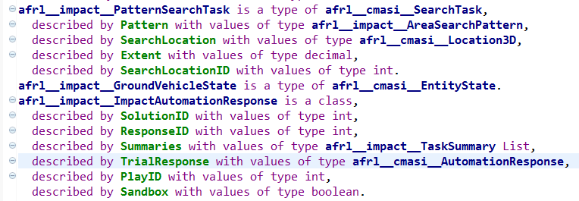
Formalization in ASSERT Modeling Data types and Variable Declarations in SADL Ontology
Snapshot of SADL Ontology Representation of AFRL UxAS Data Type
Snapshot of SADL Ontology Representation of AFRL UxAS Data Type
Data types of AFRL UxAS source code represented in SADL ontology

Slide 20
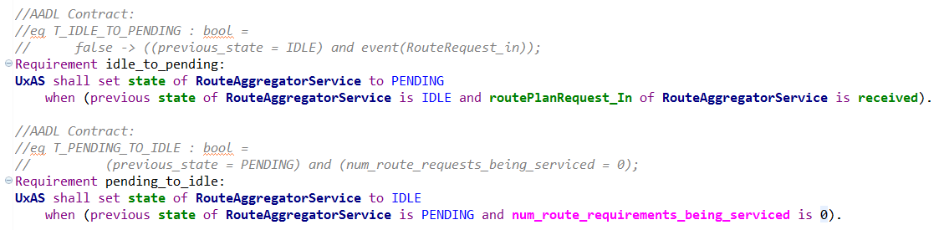
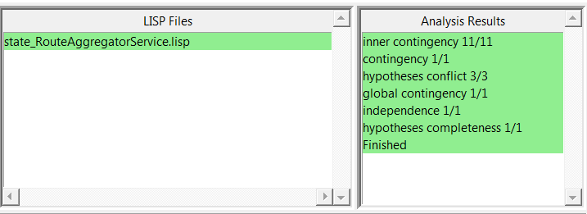
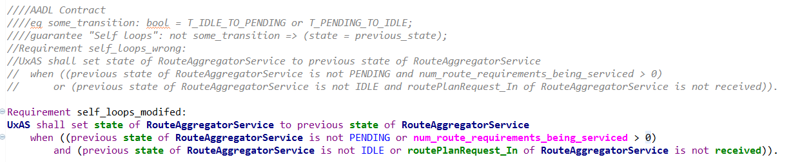
Formalization in ASSERT Illustrative example: Modified AADL Contracts Pass Analysis
What we learned: errors introduced in the manual contracts/requirements capturing process can be found earlier through automated analysis.

Slide 21
State Machine Reasoning

Slide 22
State Machine Correctness Argument
Argument pattern for individual AADL component state machine correctness:
Structure repeated for each component
Vision: Situated within a larger model correctness argument
Argument situates proposed AGREE lemmas:
Purpose
Rationale
Limitations and benefits

Slide 23
Argument-Derived Observations
Best practices/standards for AADL/AGREE use are needed
Situate proofs within modeling fault analysis/mitigation
Supports arguments that the set of lemmas are complete and correct
Additional tool support to reduce human error
E.g., lemmas and repetitive infrastructure are developed manually
Minimize repetitive concerns in the argument about human error
Enhanced integration between AADL and AGREE
Minimize repetitive arguments about AADL and AGREE consistency/agreement
A simpler higher-level protocol state machine spec for validation
Provide a structure to validate against
Simplify validation activity and simplify validation arguments

Slide 24
[Think about bridge b/w architecture and state machines (how they relate), message passing, etc.]

Slide 25
Behavioral properties of component contracts
For components with state machines, we can check that
All states and transitions are reachable
Only the states and transitions specified are possible
All input/output events are possible
We can also check that each component is realizable
Aaron: I’m inclined to move this info back up to the “What did we prove?” slide. We can discuss. Only a couple bullets here are specific to state machines.

Slide 26
[Document bugs/issues found via formalization and analysis]
Chris found stuff by talking to the Bens
Jen—ping Derek for list

Slide 27
[Placeholder for Chris Elliott’s work]
Enabling simulation
Enabling analysis from Simulink
Visualizing counterexamples

Slide 37
Lessons Learned
Many problems are identified through the process of formalization, before analysis
Data types (or an ontology), ports, and connections can be automatically extracted from code (with some moderate up front work)
Reusable (template) properties help find common mistakes
Not every error can be detected with a template property--a review of the specification itself is still worthwhile
Assurance arguments are useful to capture the “rest of the story”
Differences between the model and the real world
Specification versus intent
Enhancements to the formal analysis tools could simplify the argument
SpeAR, ASSERT, AADL/AGREE, and QVtrace are all very capable analysis tools. There are synergies between them.
Challenges: arrays, inheritance

Slide 38
Recommended Future Directions
Write contracts for the remaining components
State and analyze system-level properties (in progress)
Generate code from AADL
Generate test cases from AGREE and run on UxAS implementation
Continue documenting decisions and the assurance case for the architecture
Model of Heterogeneous System (Distributed Mission-Task-Autopilot Management-Dubin)

